Slide 1
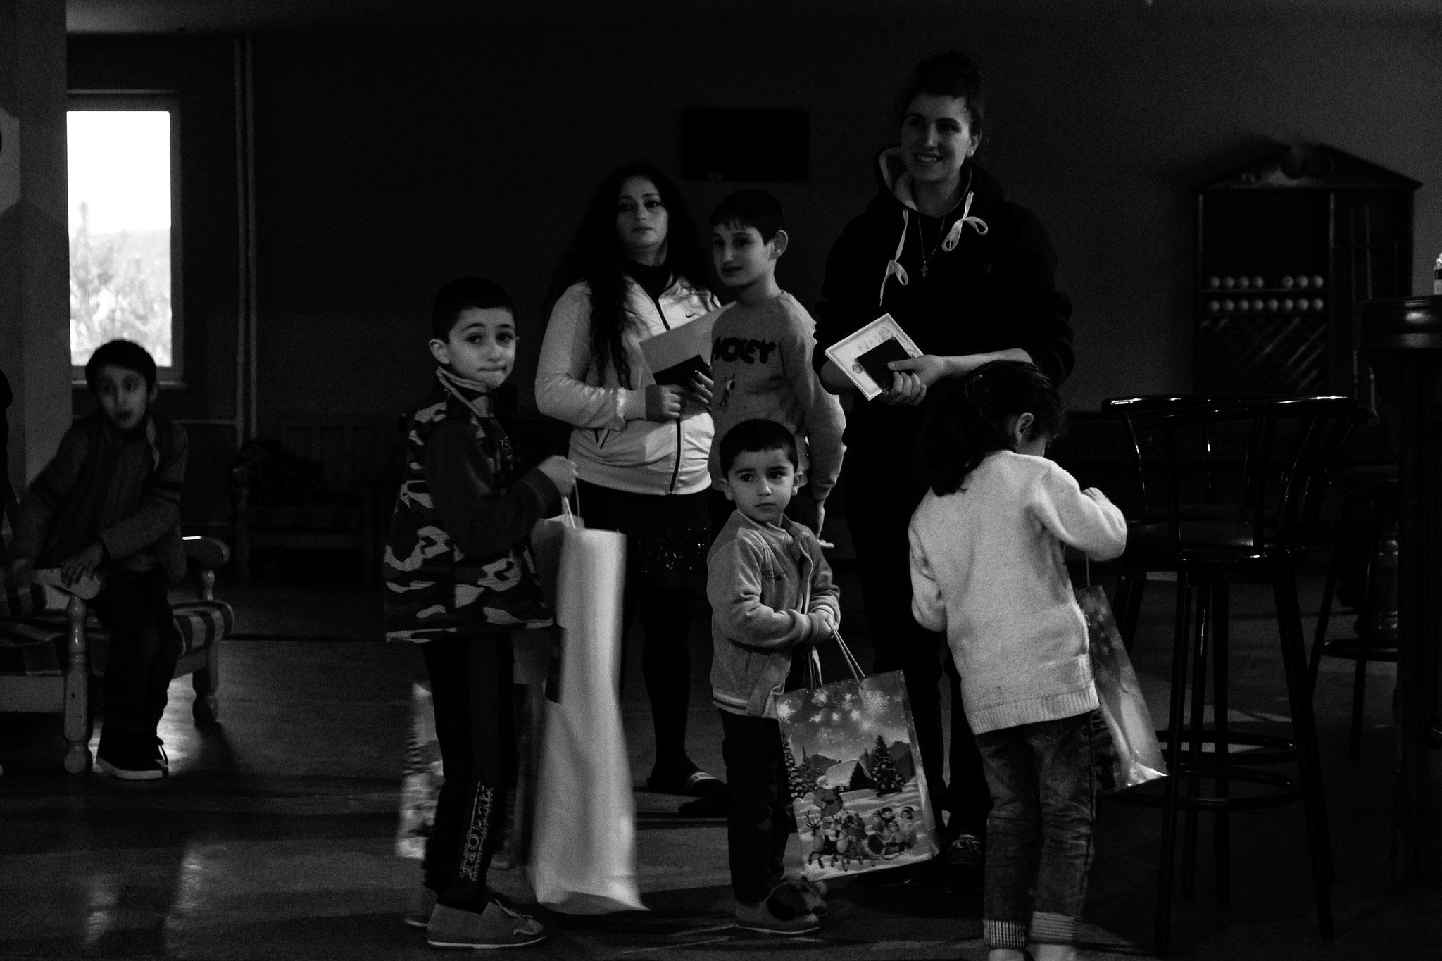

Introduction to Camp Coordination and Camp Management (CCCM)
CCCM Cluster Ukraine - 18 March 2022
Notes:
Activity 1A and B:

Slide 2
Introduction to CCCM - 18 March 2022
Objectives:
Intro on temporary solutions to displacement
Define what is Camp Management
Explain the roles and responsibilities of camp administration (CA), camp coordination (CC) and camp management (CM)
Illustrate camp management approaches
Introduce the CCCM Cluster in Ukraine
Cluster Contacts:
Marco Rotunno, interim Cluster Coordinator rotunno@unhcr.org
Alisa Ananbeh, Information Management Officer ananbeh@unhcr.org
Organizations interested to be CCCM Cluster members can subscribe to its mailing list: http://eepurl.com/hWCo_9
Notes:
Please adapt this slide to the session.

Slide 3

Temporary solutions to displacement
Notes:
Elena

Slide 4
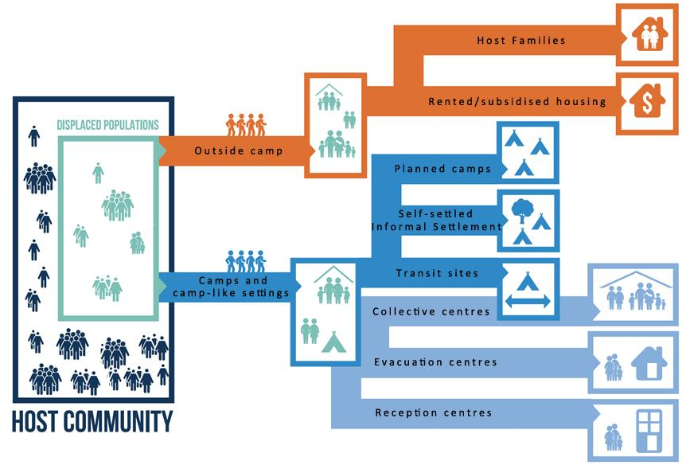
Temporary settlement options
Notes:
Elena

Slide 5
“Site” definition (CM minimum standards)
•The term “site” applies to a variety of camps and camp-like settings including planned camps, self-settled camps, collective centres, reception and transit centres, and evacuation centres. (...)
•Sites are locations where services, infrastructures and resources are shared and managed collectively. To achieve this, effective site-level coordination between all stakeholders is a central task of every CCCM actor.
Notes:
Marco

Slide 6

Key message
The types of settlements where IDPs and refugees can temporarily seek assistance and protection take a variety of forms.
Camps are a last resort and should only be established when other solutions are not feasible.
They do not provide a permanent sustainable solution, but offer temporary solutions for the provision of protection and assistance, in order to meet the basic human rights of displaced populations.
The way a displacement site is set up and managed affects the capacity of the residents to recover from disaster.
Notes:
Elena

Slide 7
What is Camp Management?
Notes:
Elena

Slide 8
Camp Management is…
…the coordination and monitoring of service provision, protection and assistance in temporary settlements in accordance with the legal protection framework and minimum humanitarian standards through community governance and participatory mechanisms.
Notes:
Elena

Slide 9
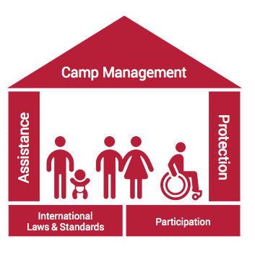
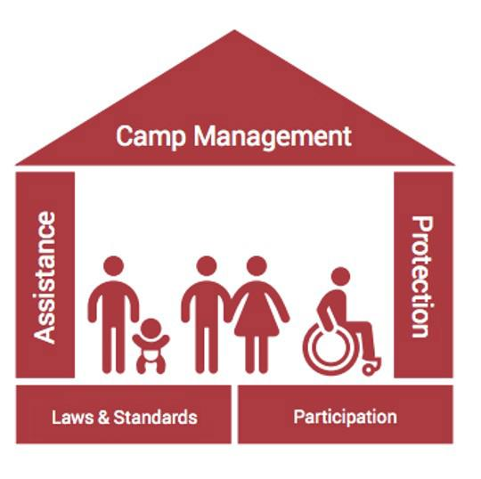
Camp Management aims to…
Provide assistance and protection to displaced populations living in sites.
Communicate and coordinate with range of actors.
Ensure the rights of the site population.
Provide a holistic approach and a cross-cutting sector response.
Notes:
Elena

Slide 10
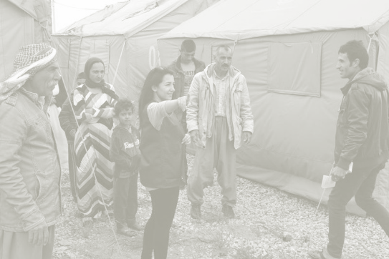
Key message
Camp Coordination and Camp Management (CCCM) strives to:
Improve the living conditions during displacement,
Ensure assistance and protection of IDPs in displacement sites,
Seek transitional and durable solutions to end temporary displacement, with an organized closure and phase out, of displacement sites.
Notes:
Elena

Slide 11
The CCCM Framework
Notes:
Marco

Slide 12
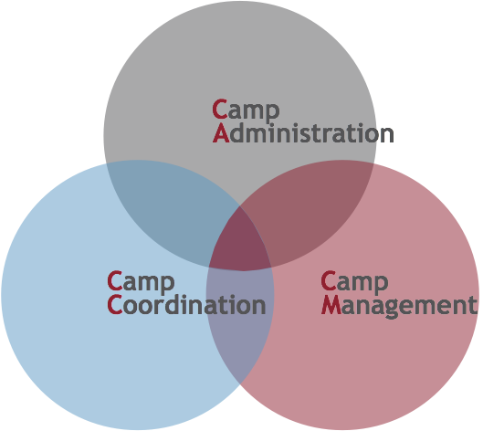

Camp Administration, Camp Coordination and Camp Management

Slide 13
General Responsibilities
Camp Administration (CA) functions are carried out by the government/national authorities to relate to the overseeing of activities in sites.
Camp Coordination (CC) functions are carried out by the CCCM cluster in an IDP Response. It entails the coordination of roles and responsibilities in the overall humanitarian camp response.
Camp Management (CM) functions are usually carried out by a UN Agency or a NGO who support the local authorities. It is the coordination of services and the maintenance of infrastructure in a single site.

Slide 14
Camp Administration
Provide oversight and the supervision of the activities in sites. This includes:
Identify site, open and close a site
Secure occupancy rights and resolve disputes arising from appropriation of land or buildings
Provide security, maintain law and order
Maintain and facilitate access to sites
Issue legal documentation, permits and licenses (e.g. birth and death certificates, ID cards, travel permits) to site residents
Organize a registration system

Slide 15
Camp Coordination
Support and Coordinate the Camp Response by providing a platform that ensures that delivery is driven by strategic priorities and avoiding duplication of service delivery. It entails:
Enhance technical CCCM capacity of local actors and stakeholders to implement CCCM activities, including area-based approaches
Develop IM tools and a joint information management system to facilitate partners’ reporting and coordination with partners, clusters, and other stakeholders for an informed decision-making
Produce and update advocacy messages
Strengthen operational CCCM coordination at national, regional and local levels, including area- based approaches
Participate in Inter-Cluster coordination mechanisms;
Form technical working groups and ad hoc thematic task forces as needed

Slide 16
Camp Management
Ensure the provision of assistance and protection for the displaced in one single site. It entails:
Set up coordination system and fora at the site level, monitor the assistance and protection and bring gaps to the attention of responsible agencies
Set up, coordinate and maintain communication with communities channels, including disseminating information and providing multisector feedback mechanisms
Collect information on the needs of the population and monitor whether all site inhabitants have safe and non-discriminatory access to available facilities and services
Set up site governance and community participation mechanisms
Monitor and maintain site infrastructure
Strategically plan activities to integrate a protection perspective into all programs and activities in the site

Slide 17
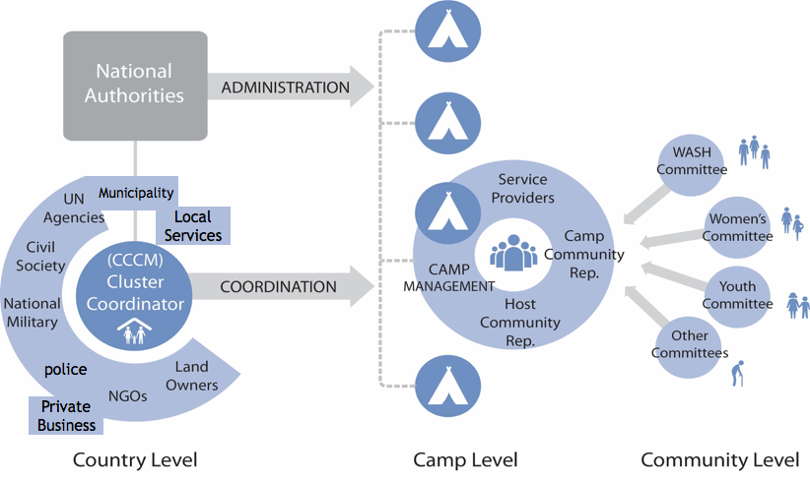
Coordination within the CCCM Framework

Slide 18
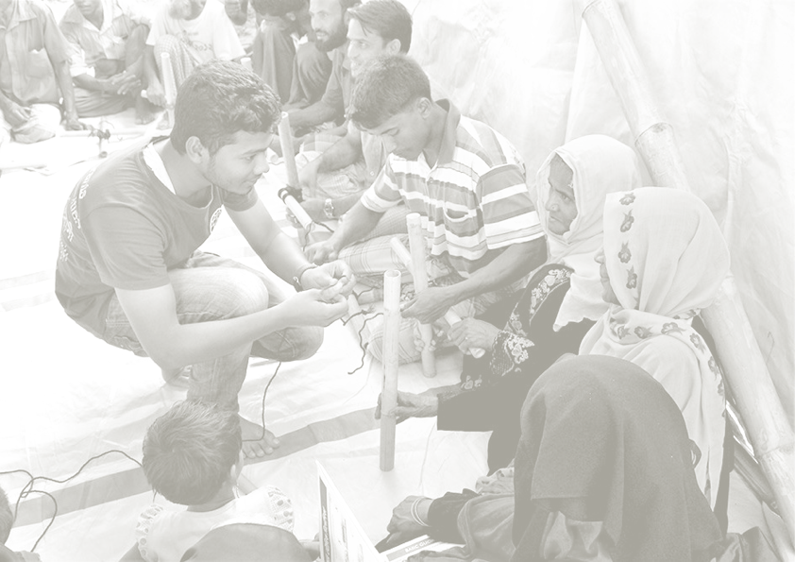
Key message
Clearly defined roles and responsibilities of CA, CC, CM are crucial to the quality of life, the degree of dignity, and future sustainable solutions for the displaced population.
A camp management agency's role is to support national authorities (as they are responsible for protecting the rights of the internally displaced persons (IDPs) on their territory) and work with the Cluster and designated protection agencies in site.

Slide 19
Camp Management Approaches
Notes:
Elena

Slide 20
Camp Management Approaches
Different organisational approaches to site management are needed to tailor the response to the displacement and operational context.
We use the generic term 'camp management agency' to refer to the range of different site team structures such as:
Classic or static Camp Management
Site Management Support
Mobile Site Management
Notes:
Elena

Slide 21
Area Based and Out of Camps
Outside camp or area based approaches apply to designated geographical areas and can take place in urban, peri-urban or rural settings.
Activities are delivered by a mobile team with adaptable skills and profiles.
The implementation focuses on setting up a centre to deliver site management services to people living in the entire community, both host and displaced.
They are most frequently used in dispersed displacement settings, where accommodation can include rented premises and communal settlements in urban contexts.
Notes:
Elena

Slide 22
Prioritized Site Management Activities in Ukraine
Support the authorities in the coordination of services at site / area level
Set up CCCM systems in sites (SOPs, coordination mechanisms, roles and responsibilities of service providers etc.) and at area level if needed for operational / coordination purposes
Establish referral mechanisms for sites
Monitor site population and services through site monitoring tools
Two-way communication with people living in sites: establish access to information for displaced populations and feedback & complaint systems
Improve living conditions of displaced people through care and maintenance, including cash for work and community projects
Capacity building on CM, humanitarian standards for authorities and relevant stakeholders
Notes:
Marco

Slide 23
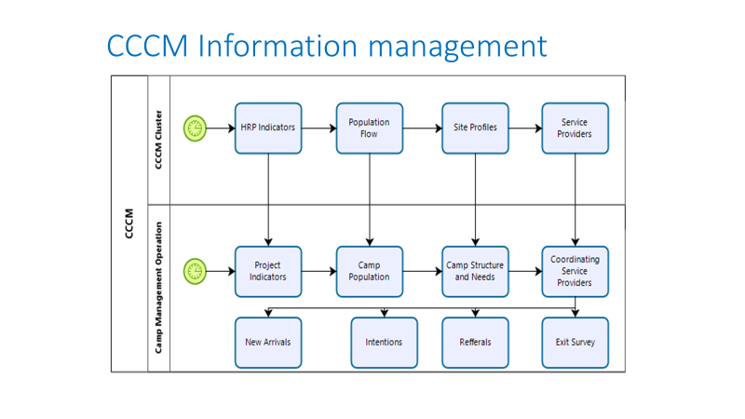
Notes:
Alisa

Slide 24
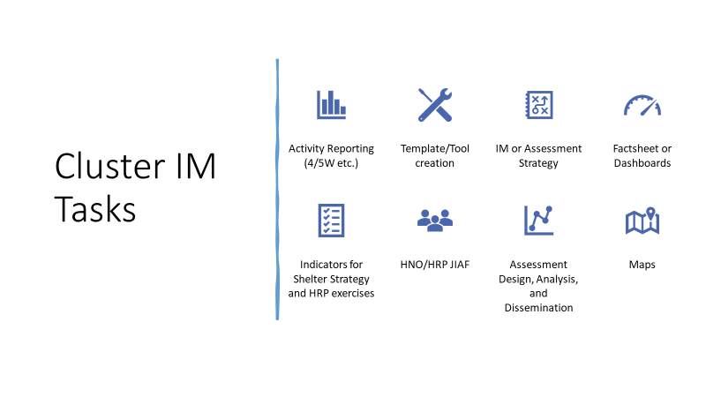
Notes:
Alisa

Slide 25
The CCCM Cluster in Ukraine
Recently activated (March 04) and lead by UNHCR
Structured with a national coordination team and subnational platforms and possibly area-based coordination in locations with high concentration of communal settings hosting IDPs
A Strategic Advisory Group (SAG) will be formed at national level to provide strategic guidance, recommendations and take key strategic decision making
Cluster members may decide on the need to establish task forces and working groups to address certain issues (contingency planning, strategy elaboration, adapting of guidance to the national context, ...)
Cluster strategic framework just issued: https://cccmcluster.org/documents/cccm-cluster-ukraine-strategic-framework
Notes:
Marco

Slide 26
Questions?
After this session…
…Please submit your questions, the Cluster will answer in writing through a Q&A document (with useful links) that will be shared with the whole Cluster Contact List and further sessions on specific topics will be carried out.
rotunno@unhcr.org; ananbeh@unhcr.org
Notes:
Marco, Elena

